Slide 1
OptiSync
Group No : 09
Group Members:
Abhishek Patil Shirish Gaikwad
Karan Thakare Abhinav Dubey
Venkateshwara Sutar

Slide 2
Introduction
Small Scale company losses customers due to lack of systematic planning and control of working. They fail to delivery orders on time due to manual control over production process and cannot quickly estimate the product/order delivery time and calculate the cost options for making decisions.
Our application allows management to check status for the current orders being executed, raw material entered in vicinity of the company is digitalized and will help overall stock analysis. Tracing of the parts in production is made easy with detail report of the parts being produced. Data generated in quality control for manufactured product is monitored with help of our application. Our application will help to track delivery and dispatch of the products manufactured.

Slide 3

Architecture
FrontEnd
ReactJS Components
CSS, Bootstrap:
Styling
Server Layer
SpringBoot Maven: Response Handling, Business Logic, Database Operations
Database
MySQL: To access and Store Data
JSON:
Data Inter-change
Request
Response

Slide 4
Tables in Data Base
Table Name | Description
client | Stores information about clients.
plans | Contains details of subscription plans.
company | Stores information about companies and their plans.
product | Stores information about products offered by companies.
orders | Records orders made by clients for products from companies.
parts | Describes different parts associated with products.
assembly | Tracks assembly details for parts in orders.
Cpm(Critical Path Method) | Captures critical path measures for production stages.
dispatch_status | Lists different dispatch statuses.
dispatch | Records the dispatch process for products.
forward | Keeps records of forward actions, like to production or assembly.
roles | Contains different user roles.
login | Stores user login credentials and their roles.
machines | Stores information about machines used in production.
master_vendor | Contains information about master vendors.
raw_materials | Holds details of raw materials used in production.
production | Records production details and quantities.
stock | Tracks stock quantities of raw materials and parts.
stores | Manages the storage process for raw materials and parts.
vendormap | Maps master vendors to companies.

Slide 5
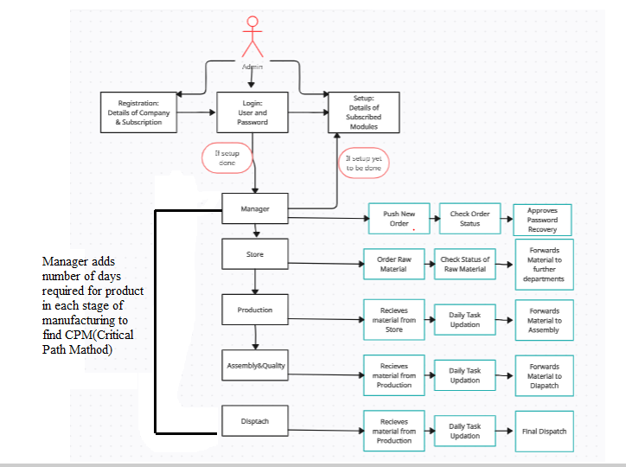
Flow of Data

Slide 6
Keys and Constraints
Table Name | Primary Key | Foreign Keys
client | client_id (PK)
plans | plan_id (PK)
company | company_id (PK) | plan_id (FK references plans(plan_id))
product | product_id (PK) | company_id (FK references company(company_id))
orders | order_id (PK) | client_id (FK references client(client_id)),<br>company_id (FK references company(company_id)),<br>product_id (FK references product(product_id))
parts | part_id (PK) | product_id (FK references product(product_id))
assembly | assembly_entry_no (PK) | order_id (FK references orders(order_id)),<br>part_id (FK references parts(part_id))
cpm | cpm_id (PK) | company_id (FK references company(company_id)),<br>product_id (FK references product(product_id)),<br>part_id (FK references parts(part_id))
dispatch_status | dispatch_status_id (PK)
dispatch | dispatch_entry_no (PK) | order_id (FK references orders(order_id)),<br>product_id (FK references product(product_id)),<br>dispatch_status (FK references dispatch_status(dispatch_status_id))
forward | forward_id (PK)
roles | role_id (PK)
login | login_id (PK) | company_id (FK references company(company_id)),<br>role_id (FK references roles(role_id))
machines | machine_id (PK) | company_id (FK references company(company_id))
master_vendor | master_vendor_id (PK)
raw_materials | raw_material_id (PK) | part_id (FK references parts(part_id))
production | entry_no (PK) | order_id (FK references orders(order_id)),<br>raw_material_id (FK references raw_materials(raw_material_id)),<br>machine_id (FK references machines(machine_id))
stock | stock_entry_no (PK) | company_id (FK references company(company_id)),<br>raw_material_id (FK references raw_materials(raw_material_id)),<br>part_id (FK references parts(part_id))
stores | store_entry_no (PK) | order_id (FK references orders(order_id)),<br>raw_material_id (FK references raw_materials(raw_material_id)),<br>part_id (FK references parts(part_id)),<br>forward_id (FK references forward(forward_id))
vendormap | vendormap_id (PK) | vendor_id (FK references master_vendor(master_vendor_id)),<br>company_id (FK references company(company_id))

Slide 7
Technologies Used
Spring Boot Maven: Java-based framework for fast application development with built-in tools. Build tool that automates tasks like compilation and dependency management.
MySQL:
Open-source database system for storing and managing structured data.
ReactJS:
JavaScript library to build dynamic user interfaces for web apps.
JSON (JavaScript Object Notation):
Lightweight data format for easy exchange between server and web app.
CSS (Cascading Style Sheets):
Stylesheet language to design and layout HTML elements.
Bootstrap:
Front-end framework for creating responsive web designs efficiently.

Slide 8
Roles and Responsibilities of User
Manager: The Manager oversees the project, handling login, registration, setup, new orders, department status checks, password recovery approval, and final product dispatch confirmation.
Stores: Stores personnel manage login, raw material ordering, material reception from vendors, stock updates, raw material status checks, and material forwarding to Production or vendors.
Production: The Production team receives materials, plans tasks, and forwards parts to Assembly from received materials.
Assembly/Quality: This department receives and inspects parts from Production, plans tasks, and forwards verified parts to Dispatch.
Dispatch: The Dispatch team receives parts, plans tasks, finalizes drafts for Manager approval, and ensures the overall product dispatch.
Admin: Admins manage login, process updates, user creation, password recovery, and user status checks.

Slide 9
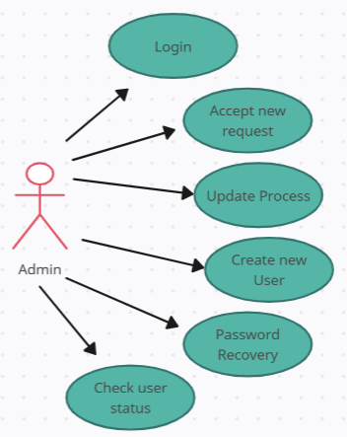
Use Cases
Admin

Slide 10
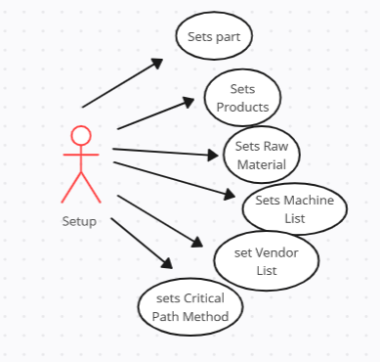
Use Cases
Setup

Slide 11
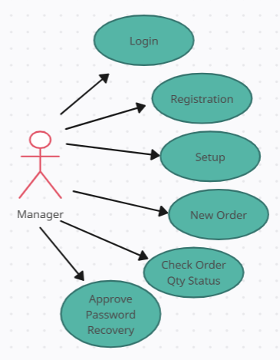
Use Cases
Manager

Slide 12
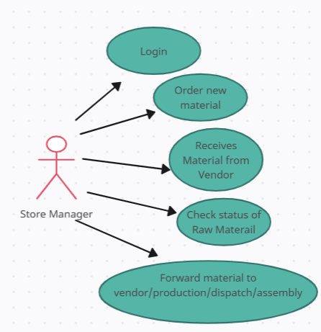
Use Cases
Store

Slide 13
Use Cases
Production

Slide 14
Use Cases
Assembly&Quality

Slide 15
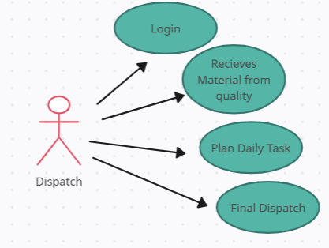
Use Cases
Dispatch

Slide 16
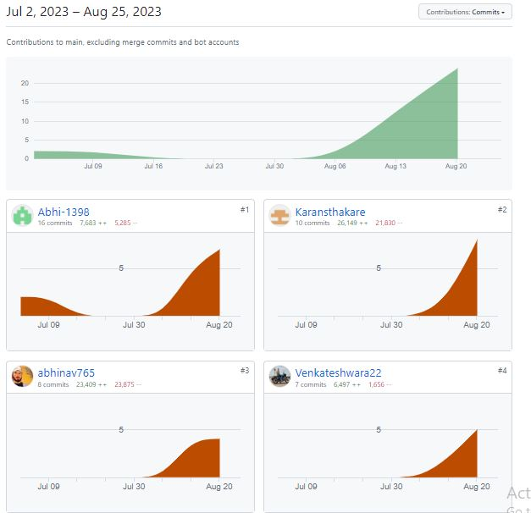
Git Contribution

Slide 17
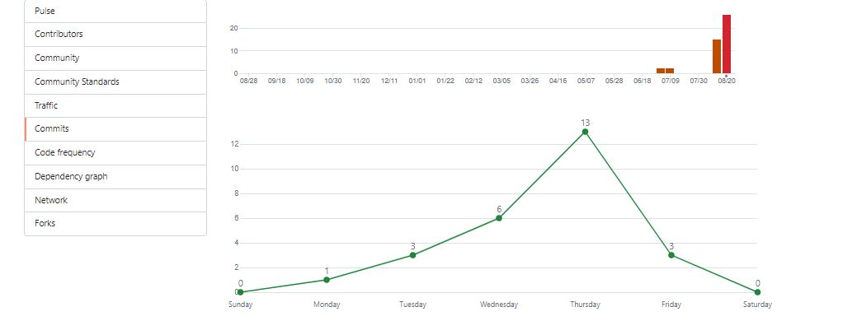
Git Commit Graph

Slide 18
Work Distribution
Abhishek Patil focused on the Production and Manager modules, ensuring that all aspects related to production processes and order dispatch are well-handled.
Karan Thakare worked on the Manager and Setup modules. They took care of setting up the managerial tasks and overall project setup, respectively.
Abhinav Dubey took charge of the Store and Login&Registration modules. This involved managing store inventory and the user authentication and registration process.
Shirish gaikwad responsibilities encompassed the Assembly& Quality and Admin modules, where attention was given to product assembly line and ensuring high-quality standards. Venkateshwara Sutar worked on the Production and Manager modules. They took care of setting up the managerial tasks and overall project production related activites respectively.

Slide 19
Future Scope
Future Scope: In the future, we can make our project even better by using React JS and Bootstrap together. This will help us improve how the project looks and how users interact with it. We can make the project more attractive and easier to use by enhancing the designs and adding interactive elements.
Also, we can work on the important parts of the project to make them work even smarter. By using Spring Boot and React more, we can add advanced features that help us make better decisions and do things more efficiently. This might include things like predicting future trends, watching how things are doing in real-time, and making some tasks happen automatically based on things we've done before.
So, in the end, the future of our project is about using React JS, Spring Boot, and MySQL to make things look and work better. And by focusing on the important parts, we can use technology to make our project not only handle what it does now but also help us do things even better in the future.

